Slide 1
iCaReMe Registry
International Diabetes Federation (IDF)
AstraZeneca

Slide 2
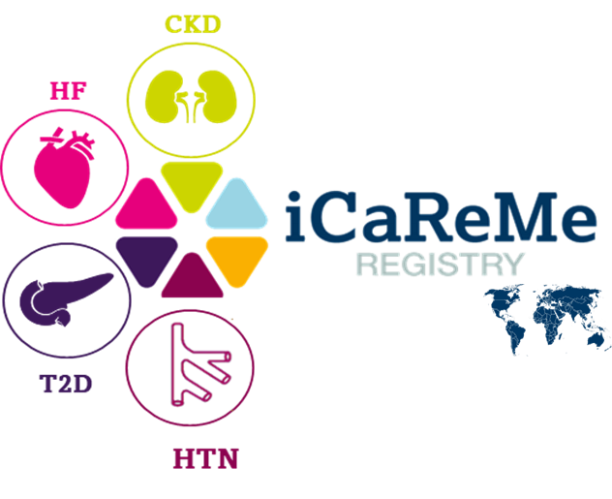
iCaReMe Registry
Overall Plan and Phases
Global coverage
Availability of the data for different publications
Large cohort
Heterogeneous
population
Long follow-up
Wide range of data
Standardized data
collection form

Slide 3
iCaReMe Registry
Rational

Slide 4
iCaReMe Registry
Study Design

Slide 5
iCaReMe Registry
Governance

Slide 6
iCaReMe Registry
Operational Model

